Slide 1
Troy School District Class of 2028
Scheduling for Incoming 9th Grade Students

Slide 2
Transition to High School
We are excited to welcome your child to high school!
What is our role as your child’s high school counselor?
8th grade is super important…FINISH STRONG!
Your child’s schedule helps to establish your educational path.
Meet your Troy High School Counselors!
Mr. Keegan Mr. Le Mr. Ali-Ahmed Mrs. Bigelow Mrs. Sobczynski Ms. Allgeier Ms. Frendt

Slide 3
Troy School District High School Curriculum
Check online for the Course Description Book
Graduation requirements listed in Course Description Book
Flow charts to simplify curricular pathways

Slide 4
High School Credits
Total Credits Needed to Graduate = 22.5 credits
0.5 credits = Semester course
1.0 credits = Full year course
3 credits per semester
6 credits per year

Slide 5
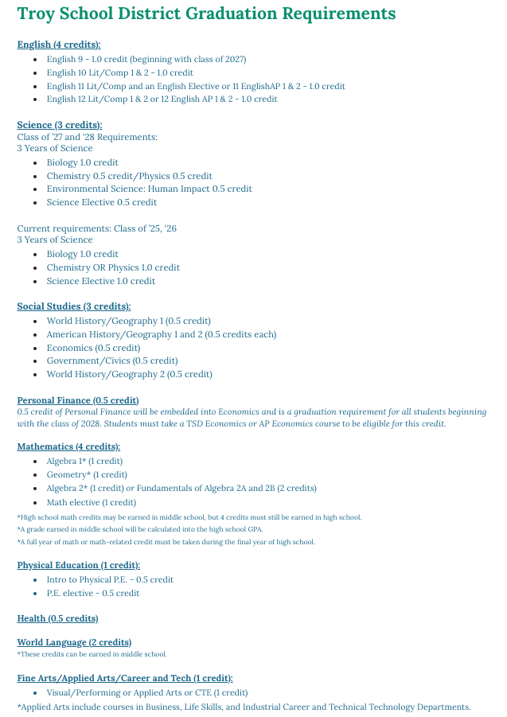
Graduation Requirements

Slide 6
9th Grade Planning Guide and Course Selection
Use the “9th Grade Course Planning Guide” to help you choose your classes before entering them into PowerSchool.
Select core academic courses first.
Be sure to choose AT LEAST 4 alternates courses (1.5 credits)
Total credits MUST ADD up to 6.0 credits
Core Academic Courses
English
Math
Science
Social Studies
World Language

Slide 7
English
English 9 (1.0 Credit)
*Select both Semester 1 and Semester 2
Summer reading is required

Slide 8
Social Studies
World History/Geography 1 (0.5 credit)
AP Human Geography (1.0 credit)
LS World History/Geography 1 & 2 (1.0 credit)
World History/Geography 1 is required for ALL 9th grade students
LS = English Language Learner Support (ELD Only)
AP Human Geography DOES NOT REPLACE World History 1/Geography

Slide 9
Science
Introductory Biology A (1.0 credit)
LS Biology (1.0 credits each)
LS = English Language Learning Support (ELD only)

Slide 10
Mathematics
Math is a cumulative subject. Once you complete one math course successfully, you will move onto the next consecutive course in sequence.
Honors courses follow the same sequence.
Algebra 1 (1.0 credit)
Geometry (1.0 credit)
Algebra 2 (1.0 credit)
Pre-Calculus (1.0 credit)
Calculus AB/BC AP (1.0 credit)

Slide 11
World Language
French
German
Spanish
Japanese
Chinese

Slide 12
Health
Health (0.5 credit)
*We highly recommend completing Health in 9th grade.

Slide 13
Physical Education
Introduction to Physical Activity 1 or 2 (0.5 credit)
Elective P.E. (0.5 credit)
Intro to P.E. 1 is intended for students who tend to be less excited by athletics or competition, whereas Intro to P.E. 2 is intended for those who are athletic and enjoy competition.
Both courses follow the same curriculum and fulfill the same graduation requirement.

Slide 14
Visual, Performing, and Applied Arts (VPAA) Electives
Art
Business
Industrial Technology
Life Skills
Music (Band, Orchestra & Vocal)
Theatre

Slide 15
Sample Student Schedule

Slide 16
Alternative Elective Classes
Important!
This is a schedule request, not a schedule guarantee.
It is critical that you select a minimum of 4 alternative ELECTIVE courses.
Be willing to take the alternative elective courses you list.
If no alternative elective courses are selected and your schedule request is not available, we will select your electives on your behalf.

Slide 17
Course Planning Worksheet

Slide 18
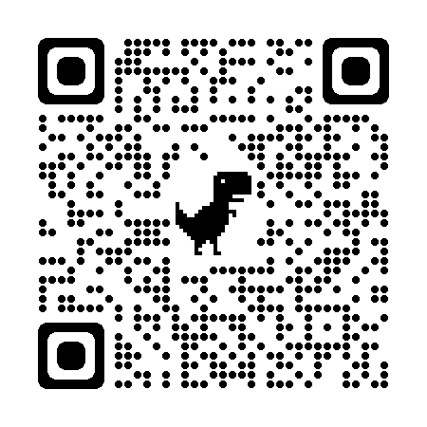
Scheduling Courses Online
Follow instructions provided on Planning Guides distributed during 8th grade presentations at the middle schools.
Enter your course requests into PowerSchool.
Green checks and 6.0 total credits with 4 elective alternates

Slide 19
Example of Online Scheduling…

Slide 20
Summer School
High School Summer School:
Registration opens April 1, 2024
*All HSSS classes are intended for recovery, not advancement.
Classes will be conducted virtually exclusively through Edgenuity.

Slide 21
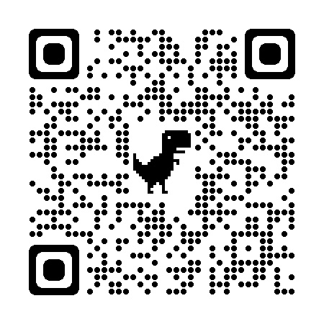
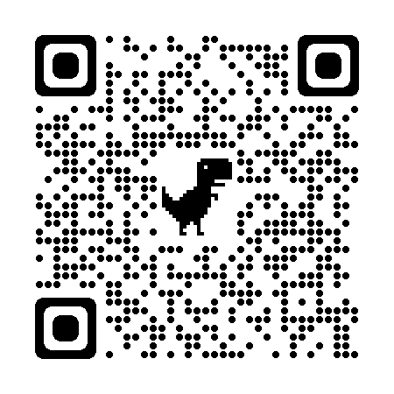
Frequently Asked Questions
Troy High Counselor Information:
Summer School Information:
Test Out Information:
Troy High School Clubs:
Troy High School Athletics:
Troy High English Summer Reading:

Slide 22
Important Dates
Individual Meetings with Counselors
April 3rd: Counselors @ Baker and Smith
April 4th: Counselors @ Boulan Park
April 5th : Counselors @ Larson
May 2nd
8th Grade Student Orientation
Notes:
We are aiming to release scheduling information by mid-February, and PowerSchool will be open to submit your schedule requests at that time. A deadline will be shared with that scheduling material. HS counselors will meet with students at the middle school to answer questions and make any adjustments.

